Slide 1
Core Game Loop
Mack 2023

Slide 2
Learning Objectives
Students will learn about the concept of opposition in game design by “programming” a balanced game of Us vs It.
Balancing the game is the primary output of this module.
By continually iterating, changing and playtesting their games, students will learn how to use the playtest > analyse > iteration loop to work towards putting the game’s players into a flow state (defined below).

Slide 3
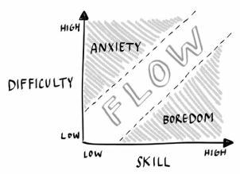
Flow and Difficulty
Flow is the idea of being “in the zone.” While in a state of flow players lose track of time and become fully immersed in the experience. Ideally, a game (and its core loops) always put the player within the flow region to increase their immersion and engagement with the content.
When a game experience dips out of the flow region, it results in either boredom or anxiety. The narrow flow band depicted in the diagram below is where the majority of a game experience should lie.
Each player has a different individual flow profile, however in this course, we’ll only be looking at flow for the average player.

Slide 4
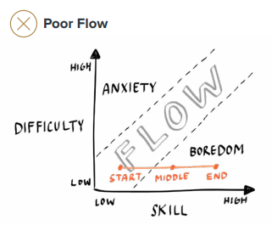
Poor Flow
The flow diagram above depicts a game where the player’s skill increases, but the difficulty does not change. The lines connecting start, middle, and end depict the changes in flow over time.
Generally speaking, the player’s skill increases over time as they gain mastery. This is represented in the diagram above by the player becoming bored throughout the middle and end of the experience.

Slide 5
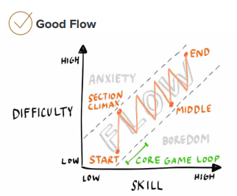
Good Flow
The diagram to the right depicts an experience where the designer increases the game’s difficulty at the same rate as the player’s skill.
Note that the curve is not linear. This is what a typical well designed flow experience looks like:

Slide 6
Good Flow
The start of a section usually begins on the lower part of the flowband to prevent players from being overwhelmed by difficulty. A section could be thought of as a core game loop (more information on core game loops in the next Teacher’s Context).
A designer typically increases difficulty until the section’s climax (E.g., a boss counter/climactic event) after which the player is allowed to start relaxing and enjoying the new skills they learned. This downtime is important to prevent player exhaustion.
Section climaxes provide moments of tension and triumph throughout the experience. As the player starts to get bored in this downswing of difficulty, the process will typically start afresh with a new challenge before they become bored.
Notes:
Note that the player’s skill is constantly improving throughout the process.
These ebbs and flows in intensity are pivotal to prevent the player from becoming bored or exhausted.

Slide 7
Influencing Flow
There are several factors that can cause a player to drift into the “boredom” category:
Skill exceeds difficulty for prolonged periods of time.
Too much downtime (E.g., having to wait for players to take their turn).
Repetition of content without a meaningful difference between the experiences.
Notes:
Note that the player’s skill is constantly improving throughout the process.
These ebbs and flows in intensity are pivotal to prevent the player from becoming bored or exhausted.

Slide 8
Influencing Flow
There are several factors that can cause a player to drift into the “anxiety” category:
Difficulty exceeds skill for prolonged periods of time.
Too much complexity (overwhelming game boards, lengthy rules manuals, overloaded user interfaces).
No downtime, leading to prolonged periods in a stressful situation.
Time pressure.
Analysis paralysis (too many choices).
Natural exhaustion (burnout, heightened intensity for too long).
Particularly if an experience fails to oscillate and encroaches on the anxiety border for a prolonged period of time.
Notes:
Note that the player’s skill is constantly improving throughout the process.
These ebbs and flows in intensity are pivotal to prevent the player from becoming bored or exhausted.

Slide 9
Core Game Loop
The core game loop is the repeated set of actions that a player engages in while engaging with the game.
For example, in Super Mario Bros, the core game loop is:
■ Traverse through the level.
■ Hit blocks.
■ Collect items.
■ Defeat enemies.
■ Reach the flag to get to the next level.
■ Repeat.
Notes:
Note that the player’s skill is constantly improving throughout the process.
These ebbs and flows in intensity are pivotal to prevent the player from becoming bored or exhausted.

Slide 10
Core Game Loop
At the next level (of abstraction) up, the core game loop would look something like:
■ Complete level.
■ Complete level.
■ Complete level.
■ Defeat boss.
Notes:
Note that the player’s skill is constantly improving throughout the process.
These ebbs and flows in intensity are pivotal to prevent the player from becoming bored or exhausted.

Slide 11
Satisfaction
An important reason to design a core game loop is to build positive expectations from the player for a game experience; either consciously or subconsciously.
Decisively and ceremoniously meeting this expectation results in satisfaction for a player, E.g., defeating a boss/player and receiving a reward or leveling up.

